Slide 1
Numerical methods for Chemical Engineers: Non-linear equations
Prof.dr.ir. Martin van Sint Annaland Dr.ir. Ivo Roghair
Chemical Process Intensification

Slide 2
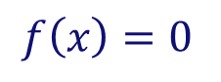
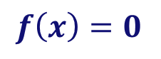
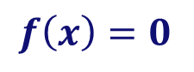
Content
How to solve:
One dimensional case:
“Bracket or ‘trap’ a root between bracketing values, then hunt it down like a rabbit.”
Multi-dimensional case:
N equations in N unknowns: You can only hope to find a solution. It may have no (real) solution, or more than one solution!
Much more difficult!! “You never know whether a root is near, unless you have found it”
$$f\left(x\right)=0$$
for arbitrary functions f
“Root finding”
(i.e. move all terms to the left)
$$f\left(x\right)=0$$
$$f\left(x\right)=0$$

Slide 3
Outline
One-dimensional case:
Direct iteration method
Bisection method
Secant and false position method
Brent’s method
Newton-Raphson method
Multi-dimensional case:
Newton-Raphson method
Broyden’s method
Do not use routines as black boxes without understanding them!!!
Introduction to underlying ideas and algorithms
Exercises in how to program the methods in Excel and MATLAB.

Slide 4
General idea
Root finding proceeds by iteration:
Start with a good initial guess (crucially important!!)
Use an algorithm to improve the solution until some predetermined convergence criterion is satisfied
Pitfalls:
Convergence to the wrong root…
Fails to converge because there is no root…
Fails to converge because your initial estimate was not close enough…
Hamming’s motto: the purpose of computing is insight, not numbers!!
It never hurts to inspect your function graphically
Pay attention to carefully select initial guesses

Slide 5
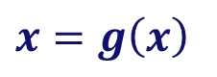

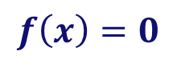



Direct iteration method/successive substitutions
$$f\left(x\right)=0$$
⇒
$$x=g\left(x\right)$$
Rewrite
Start with an initial guess:
Calculate new estimate with:
Continue iteration with:
Proceed until:
$$x_{1}$$
$$x_{2}=g\left(x_{1}\right)$$
$$x_{i+1}=g\left(x_{i}\right)$$
$$\left|x_{i+1}−x_{i}\right|<ϵ$$
When the process converges, taking a smaller value for ∈ results in a more accurate solution, however more iterations need to be performed.
y = x
y = g(x)
x₁
x₂
x₃
x₄

Slide 6

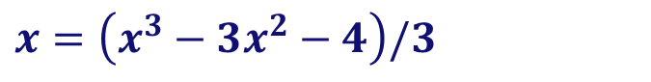
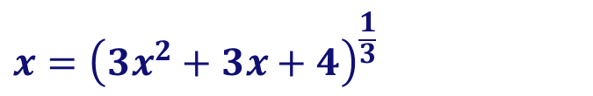
Direct iteration method
$$x^{3}−3x^{2}−3x−4=0$$
Exercise 1: Find the root of
with the direct iteration method
Rewrite as:
Solve in Excel
Solve in Matlab
Rewrite as:
Solve in Excel
Solve in Matlab
$$x={\left(3x^{2}+3x+4\right)}^{\frac{1}{3}}$$
$$x=\left(x^{3}−3x^{2}−4\right)/3$$

Slide 7
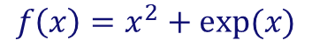
Intermezzo: functions revisited
In MATLAB you can define your own functions, allowing re-use of certain functionalities. We now define the mathematical function in a new file f.m:
The first line contains the function keyword
y is defined as output, x is defined as input
The computation can use x as a scalar as well as a vector
If x is a vector, y is also a vector.
$$f\left(x\right)=x^{2}+exp⁡(x)$$
function y = f(x)
y = x.^2 + exp(x);
end

Slide 8
Anonymous functions
If you do not want to create a file, you can create an anonymous function
g: the name of the function
@: indicator of a function handle
x: the input argument
A function handle points to a function, but it behaves as a variable. You can pass a function handle as an argument!
>> g = @(x) (x.^2 + exp(x))
>> g(0:0.1:1)

Slide 9
Passing functions in Matlab
For example: to solve f(x) = x² − 4x + 2 = 0 numerically, we can write a function that returns the value of f:
The function handle can be used as an alias:
We can then call a solving routine (e.g. fzero):
function f = MyFunc(x) f = x.^2 – 4*x + 2;
return
(Note: case sensitive!!)
>> f = @MyFunc; a = 4; b = f(a)
>> ans = fzero(@MyFunc,5)
>> fzero(@(x) x.^2-4*x+2,5)

Slide 10
Passing functions in Matlab
We can also make our own function, that takes the function handle as an input (save as draw_my_function.m):
Now we can call the function with a function handle, which points to an anonymous function or a common function:
function [] = draw_my_function(func)
% Draws a function in the range [0 10] using 20 data
% points. ‘func’ is a function handle that can point to
% any actual function.
x = linspace(0, 10, 20);
y = func(x);
plot(x,y,”-o”);
end
>> f = @(x) (x.^2 - 4*x + 2);
>> draw_my_function(f)
>> ezplot(f, [0 10])

Slide 11
Direct iteration method
$$x^{3}−3x^{2}−3x−4=0$$
Exercise 1: Find the root of
with the direct iteration method
Rewrite as:
Solve in Excel
Solve in Matlab
Rewrite as:
Solve in Excel
Solve in Matlab
$$x={\left(3x^{2}+3x+4\right)}^{\frac{1}{3}}$$
$$x=\left(x^{3}−3x^{2}−4\right)/3$$

Slide 12
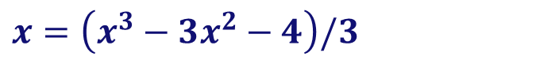
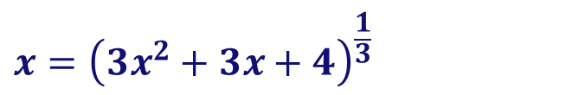
Direct iteration method
$$x^{3}−3x^{2}−3x−4=0$$
Exercise 1: Find the root of
with the direct iteration method in Excel
$$x={\left(3x^{2}+3x+4\right)}^{\frac{1}{3}}$$
$$x=\left(x^{3}−3x^{2}−4\right)/3$$
1 | 2.5
2 | 3.11584
3 | 3.489024
4 | 3.708113
5 | 3.834375
6 | 3.906376
7 | 3.94719
8 | 3.970248
9 | 3.98325
10 | 3.990573
1 | 2.5
2 | -2.375
3 | -11.4395
4 | -631.188
5 | -8.4E+07
6 | -2E+23
7 | -2.6E+69
8 | -6E+207
9 | #NUM!
10 | #NUM!
=(3*x1^2+3*x1+4)^(1/3)
=(x1^3-3*x1^2-4)/3
Converges!
Diverges!

Slide 13
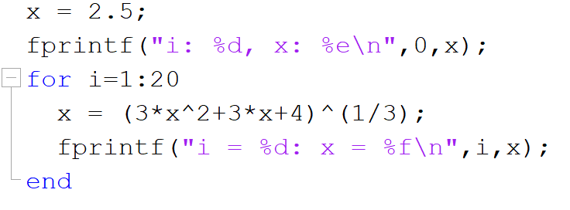
Direct iteration method
$$x^{3}−3x^{2}−3x−4=0$$
Exercise 1: Find the root of
with the direct iteration method in Matlab
With simple script:
Not very flexible/reusable ⇒ use functions!

Slide 14
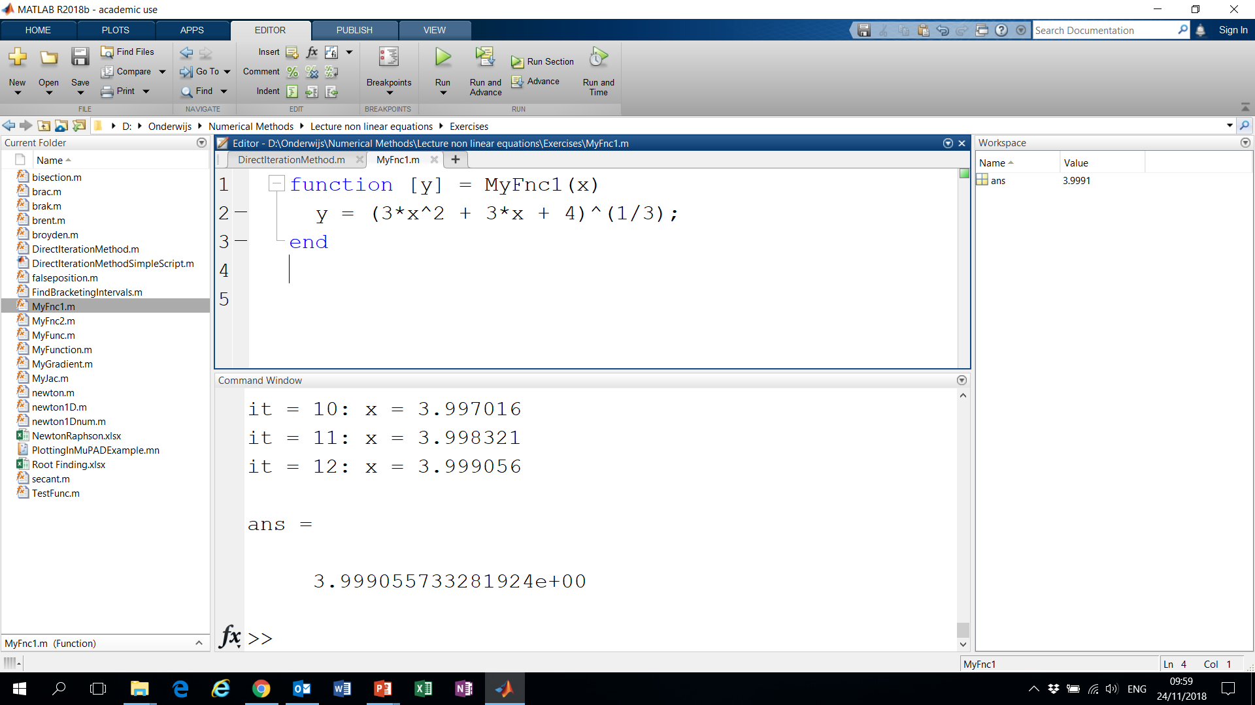

Direct iteration method
$$x^{3}−3x^{2}−3x−4=0$$
Exercise 1: Find the root of
with the direct iteration method in Matlab
First define the functions

Slide 15
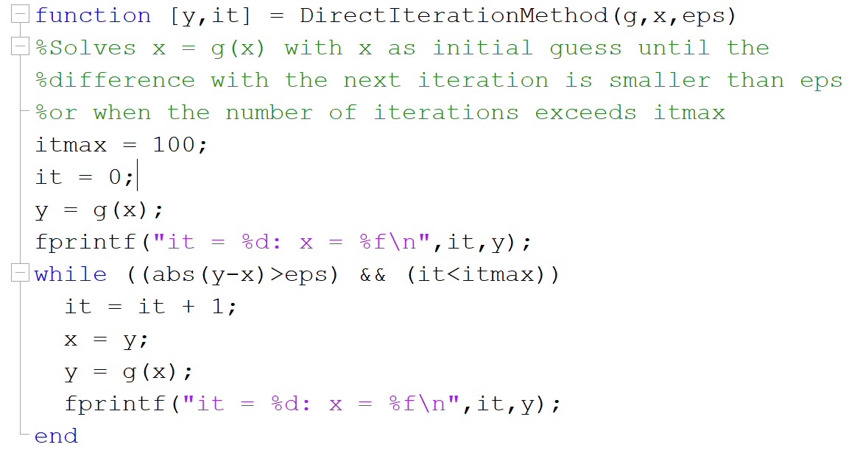
Direct iteration method
$$x^{3}−3x^{2}−3x−4=0$$
Exercise 1: Find the root of
with the direct iteration method in Matlab
Make function to carry out Direct Iteration algorithm:

Slide 16
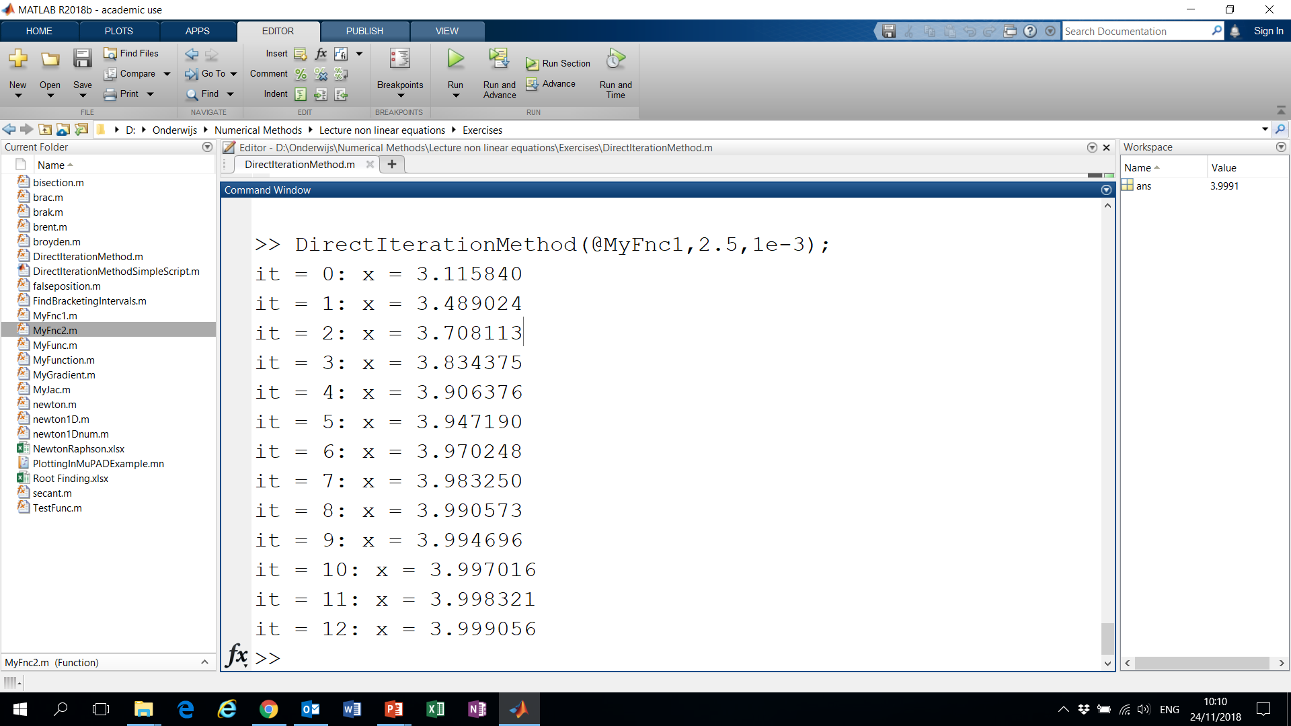
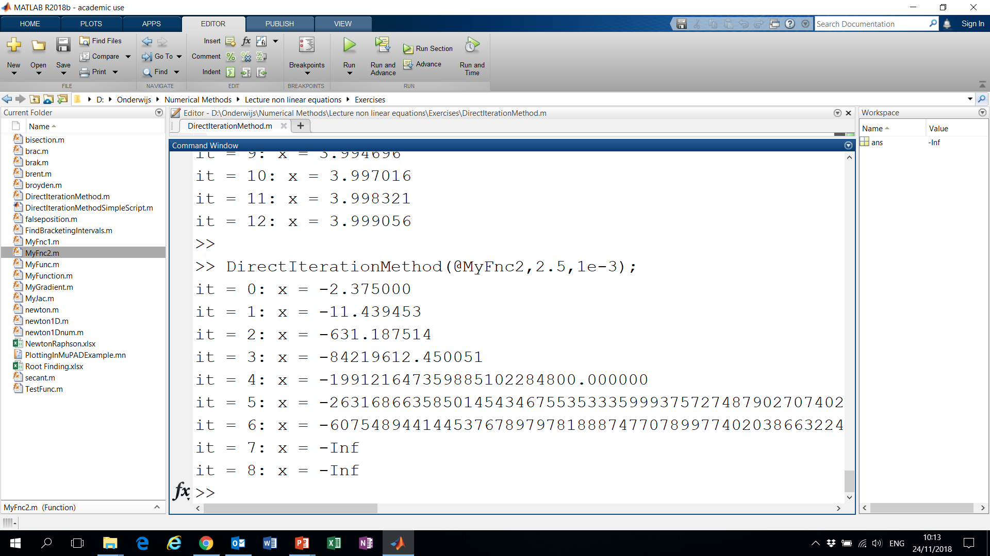
Direct iteration method
$$x^{3}−3x^{2}−3x−4=0$$
Exercise 1: Find the root of
with the direct iteration method in Matlab
Call Direct Iteration function with:
Why does it converge with MyFnc1 and diverge with MyFnc2?

Slide 17
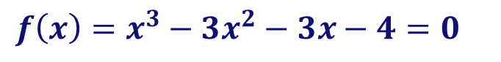


Direct iteration method
$$f\left(x\right)=x^{3}−3x^{2}−3x−4=0$$
Exercise 1: Find the root of
with the direct iteration method
Method only works when
$$\left|g′\left(x_{i}\right)\right|<1$$
2
3
1
And even then not very fast ...
MyFnc1
MyFnc2
$$x=g\left(x\right) ≈g\left(x_{i}\right)+g^{′}\left(x_{i}\right)\left({x−x}_{i}\right)$$
$$g\left(x_{i+1}\right)=g\left(x_{i}\right)+g^{′}\left(x_{i}\right)\left({x_{i+1}−x}_{i}\right)$$
$$x_{i+2}=x_{i+1}+g^{′}\left(x_{i}\right)\left({x_{i+1}−x}_{i}\right)$$
2
1
$$\left|x_{i+2}−x_{i+1}\right|=\left|g^{′}\left(x_{i}\right)\right|\left|{x_{i+1}−x}_{i}\right|$$
Convergence ⇒
$$\left|g^{′}\left(x_{i}\right)\right|≤1$$

Slide 18
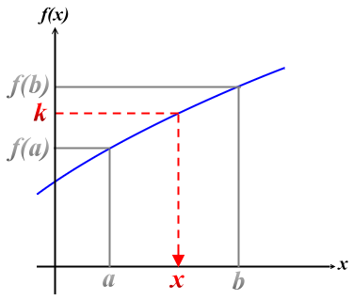
Bracketing
Bracketing a root = knowing that the function changes sign in an identified interval
f(x)
A root is bracketed in the interval (a,b), if f(a) and f(b) have opposite signs
a
b
⇒ At least one root must lie in this interval, if the function is continuous
Intermediate Value Theorem If f(x) is continuous on [a,b] and k is a constant that lies between f(a) and f(b), then there is a value x∈[a,b] such that f(x) = k

Slide 19
Bracketing
Bracketing a root = knowing that the function changes sign in an identified interval
f(x)
a
b
General best advise:
Always bracket a root before trying to converge…
Never allow your iteration method to get outside the best bracketing bounds…

Slide 20
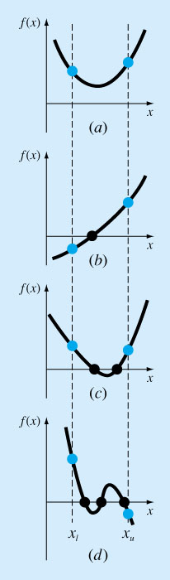
General idea
Examples of pitfalls of bracketing…
No answer (no root)
Oops!! (two roots!!)
Nice case (one root)
Three roots (might work for a while!)

Slide 21
Bracketing
Exercise 2:
Write a function in MATLAB to bracket a function given an initial guessed range x₁ and x₂. (via expansion of the interval)
Write a program to find out how many roots exist (at minimum) in the interval x₁ and x₂.
Of course these functions can then be combined to create a function that returns bracketing intervals for different roots.

Slide 22
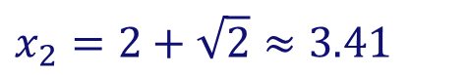
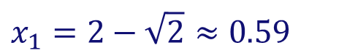
Bracketing
Exercise 2: Function to bracket a function
If possible, first make a graph: for example via
>> x=0:0.1:5;
>> y=x.^2-4*x+2;
>> figure;
>> plot(x,y,x,zeros(size(x));
>> axis tight; box on;
Makes immediately clear that there are two roots.
$$x_{1}=2−\sqrt{2}≈0.59$$
$$x_{2}=2+\sqrt{2}≈3.41$$

Slide 23
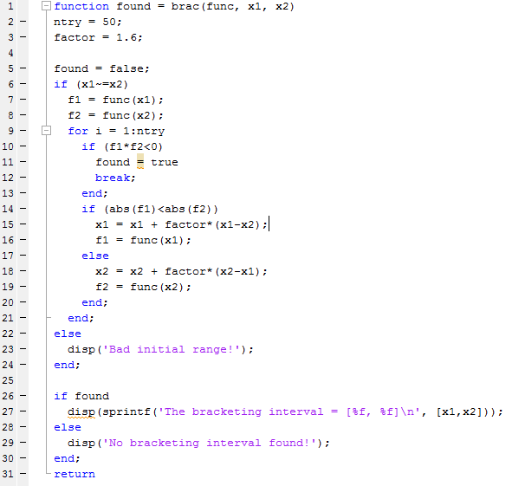
Bracketing
Exercise 2: Function to bracket a function
a function to expand the interval (x₁,x₂) maximally 2⁵⁰ ~ 10¹⁵, untill a root is found
returns true when root is found and false otherwise
displays results

Slide 24
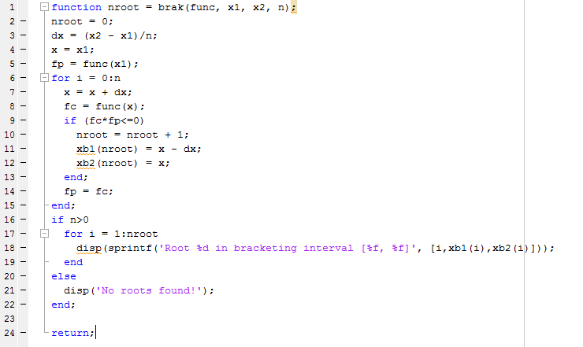
Bracketing
Exercise 2: Function to bracket a function
a function to subdivide the interval (x₁,x₂) in n parts and examines whether there is at least one root
Returns the left and right boundaries of the intervals of the roots in xb1, xb2

Slide 25
Bisection method
Bisection algorithm:
Over some interval it is known that the function will pass through zero, because the function changes sign
Evaluate function value at the interval’s midpoint and examine its sign
Use the midpoint to replace whichever limit has the same sign
4
2
f(x)
5
It cannot fail, but relatively slow convergence!
a
b
3
1

Slide 26
Bisection
Exercise 3:
Write a function in Excel to find a root of a function using the bisection method
Assume that an initial bracketing interval (x₁, x₂) is provided
Also the required tolerance is specified (which tolerance?)
Also output the required number of iterations
Do the same in MATLAB

Slide 27
Bisection method
Exercise 3: Bisection method in Excel
=IF(f1*fmid<0;x1;xmid)
=IF(f2*fmid<0;x2;xmid)
xmid = 0.5*(x1 + x2)
fmid = f(xmid)

Slide 28
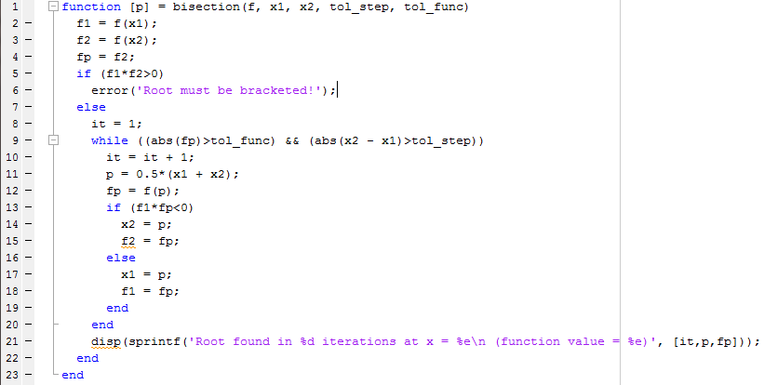
Bisection method
Exercise 3: Bisection method in MATLAB
Note1: We have used a criterion for the function value and the step size!
Note2: usually while loop needs protection for maximum number of iterations (but here bisection is sure to convergence…)
Root found in 25 iterations required. Can we do better?
>> bisection(@(x) x^2-4*x+2,0,2,1e-7,1e-7);

Slide 29
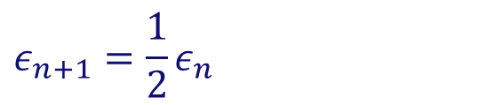
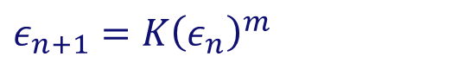


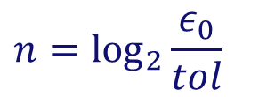
Bisection method
Required number of iterations?
After each iteration the interval bounds containing the root decrease by a factor of 2:
Order of convergence = 1
Must succeed:
More than root ⇒ bisection will find one of them
No root, but singularity ⇒ bisection will find singularity
$$ε_{n+1}=\frac{1}{2}ε_{n}$$
$ε_{0}=$
$$n=\log_{2}{\frac{ε_{0}}{tol}}$$
initial bracketing interval
⇒
$tol=$
desired tolerance
i.e. after 50 iterations the interval is decreased by factor 2⁵⁰ = 10¹⁵!
(Mind machine accuracy when setting tolerance!)
$$ε_{n+1}=K{\left(ε_{n}\right)}^{m}$$
m = 1: linear convergence
m = 2: quadratic convergence

Slide 30
Secant and False position method
Secant/False position (= Regula Falsi) method
Faster convergence (provided sufficiently smooth behaviour)
Difference with bisection method in choice of next point:
Bisection: mid-point of interval
Secant/False position: point where the approximating line crosses the axis
One of the boundary points is discarded in favor of the latest estimate of
Secant: retains the most recent of the prior estimates
False position: retains prior estimate with opposite sign, so that the points continue to bracket the root

Slide 31
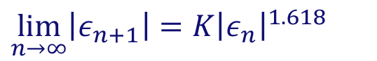
Secant and False position method
Secant method
False position method
2
2
f(x)
f(x)
3
3
5
5
4
a
b
a
b
4
1
1
Secant: slightly faster convergence:
False position: guaranteed convergence
$$\lim_{n→∞}\left|ε_{n+1}\right|=K{\left|ε_{n}\right|}^{1.618}$$

Slide 32
Secant and False position method
Exercise 4:
Write a function in Excel and MATLAB to find a root of a function using the Secant and the False position methods
Assume that an initial bracketing interval (x₁, x₂) is provided
Also the required tolerance is specified
Also output the required number of iterations
Compare the bisection, false position and secant methods

Slide 33
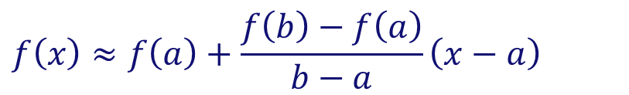
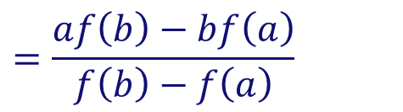

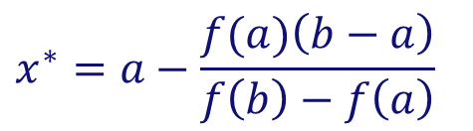
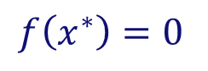
Secant and False position method
Exercise 4:
Determination of the abscissa of the approximating line:
Determine the approximating line:
Determine abscissa:
f(b)
$$f\left(x\right)≈f\left(a\right)+\frac{f\left(b\right)−f\left(a\right)}{b−a}\left(x−a\right)$$
f(x)
$$f\left(x^{∗}\right)=0$$
a
b
$$x^{∗}$$
$$x^{∗}=a−\frac{f(a)\left(b−a\right)}{f\left(b\right)−f\left(a\right)}$$
⇒
$$=\frac{af\left(b\right)−bf\left(a\right)}{f\left(b\right)−f\left(a\right)}$$
f(a)

Slide 34
Secant and False position method
Exercise 4: False position method in Excel
=IF(f1*fabsc<0; x1;xabsc)
=IF(f2*fabsc<0; x2;xabsc)
x absc = x1 – f1*(x2 – x1)/(f2 – f1)
f absc = f(x absc)

Slide 35
Secant and False position method
Exercise 4: Secant method in Excel
=min(x_{it-2},x_{it-1})
=max(x_{it-2},x_{it-1})
x absc = x1 – f1*(x2 – x1)/(f2 – f1)
f absc = f(x absc)

Slide 36
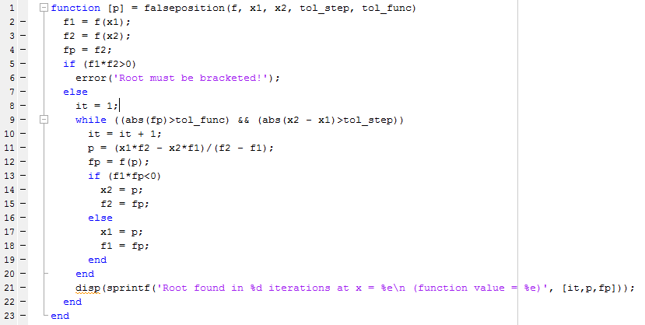
Secant and False position method
Exercise 4: False position method in MATLAB
The only difference with bisection!
Root found in 12 iterations! (Bisection needed 25 iterations)
>> falseposition(@(x) x^2-4*x+2,0,2,1e-7,1e-7);

Slide 37
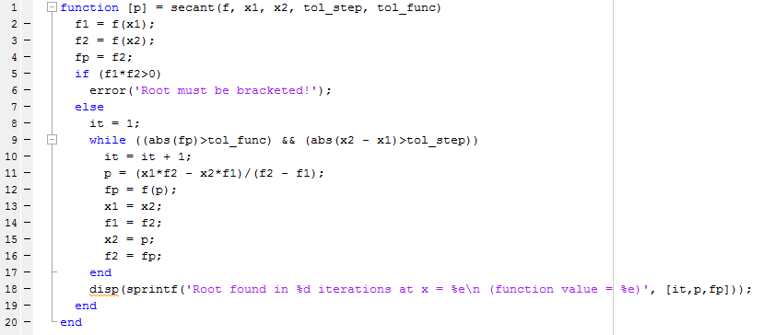
Secant and False position method
Exercise 4: Secant method in MATLAB
The only difference with False position method!
Secant method: 8 iterations False position: 12 iterations Bisection: 25 iterations
>> secant(@(x) x^2-4*x+2,0,2,1e-7,1e-7);

Slide 38
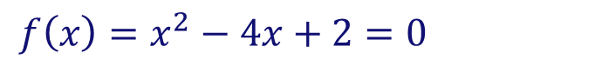
Secant and False position method
Comparison of methods
$$f\left(x\right)=x^{2}−4x+2=0$$
tol_eps, tol_func = 1e-15, and (x₁, x₂) = (0,2)
Method
Nr. iterations
Bisection
52
False position
22
Secant
9
Compare with:
>> fzero(@(x) x^2-4*x+2,2,optimset('TolX',1e-15,'Display','iter'))
Note the initial bracketing steps in fzero!

Slide 39
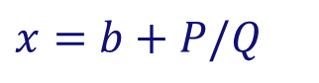
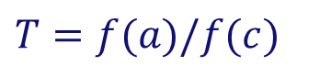
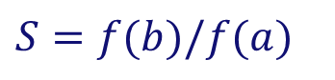
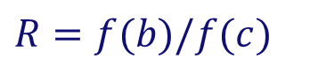
Brent’s method
Superlinear convergence + sureness of bisection
Keep track of superlinear convergence, and if not, intersperse with bisection steps (assures at least linear convergence)
Brent’s method (is implemented in MATLAB’s fzero): root-bracketing + bisection/secant/inverse quadratic interpolation
Inverse quadratic interpolation: uses 3 prior points to fit an inverse quadratic function (i.e. x(y) ) with contingency plans, if root falls outside brackets:
When P/Q does not land within the bounds or when bounds are not collapsing fast enough ⇒ take bisection step
$$x=b+P/Q$$
$$R=f(b)/f(c)$$
$P=S\left[T\left(R−T\right)\left(c−b\right)−\left(1−R\right)\left(b−a\right)\right]$
$$S=f(b)/f(a)$$
$Q=\left(T−1\right)\left(R−1\right)\left(S−1\right)$
$$T=f(a)/f(c)$$
b = current best estimate P/Q = ought to be a ‘small’ correction

Slide 40
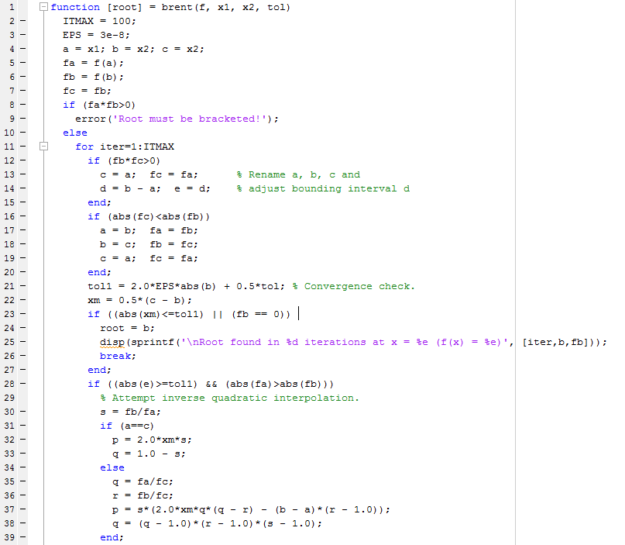
Brent’s method

Slide 41
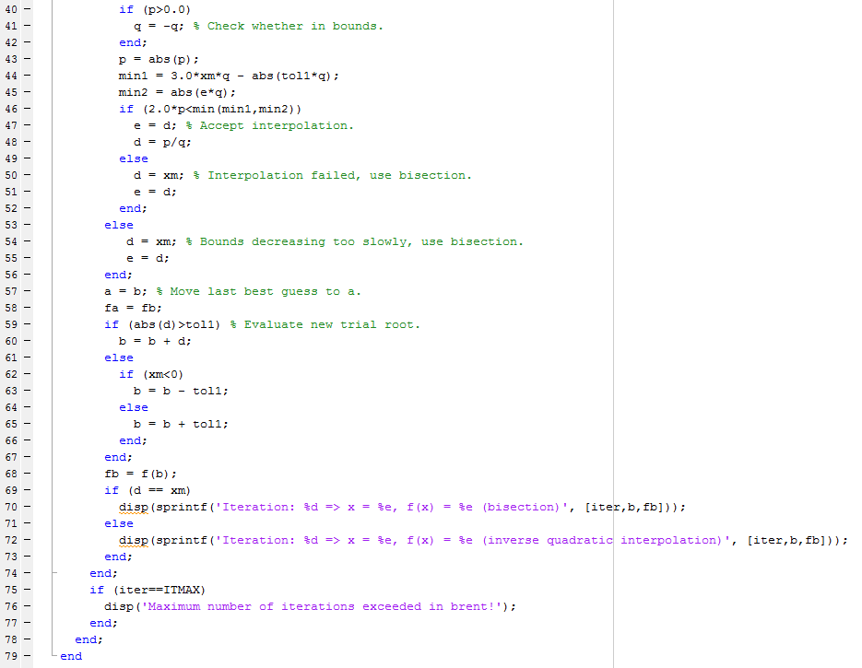
Brent’s method

Slide 42
Non-linear equation solving in Excel
Excel comes with a goal-seek and solver function. Some prerequisites have to be installed. For Excel 2010:
Install via Excel →File → Options → Add-Ins → Go (at the bottom) → Select solver add-in. You can now call the solver screen on the 'data' menu ('Oplosser' in Dutch).
The procedure to solve is then:
Select the goal-cell, and whether you want to minimize, maximize or set a certain value
Enter the variable cells; Excel is going to change the values in these cells to get to the desired solution
Specify the boundary conditions (e.g. to keep certain cells above zero)
Click 'solve' (possibly after setting the advanced options).

Slide 43
Excel: goal-seek example
Goal-Seek can be used to set the goal-cell to a specified value (e.g. zero) by changing another cell:
Open Excel and type the following:
Go to tab Data → What-if Analysis → Goal Seek
Set cell: B2
To Value: 0
By changing cell: B1
OK: You’ll find a solution of 0.3333…
 | A | B
1 | x | 3
2 | f(x) | =-3*B1^2-5*B1+2
3

Slide 44
Excel: solver example
The solver is used to change the value in a goal-cell, by changing the values in 1 or more other cells while keeping boundary conditions:
Use the following sheet:
Go to tab Data → Solver
Goalfunction: C2 (value of: 0)
Add boundary condition: C3 = 0
By changing cells: $B$2:$B$3 (you can just select the cells)
Solve. You will find B2=0 and B3=2.
 | A | B | C
1 |  | x | f(x)
2 | x1 | 3 | =2*B2*B3-B3+2
3 | x2 | 4 | =2*B3-4*B2-4

Slide 45
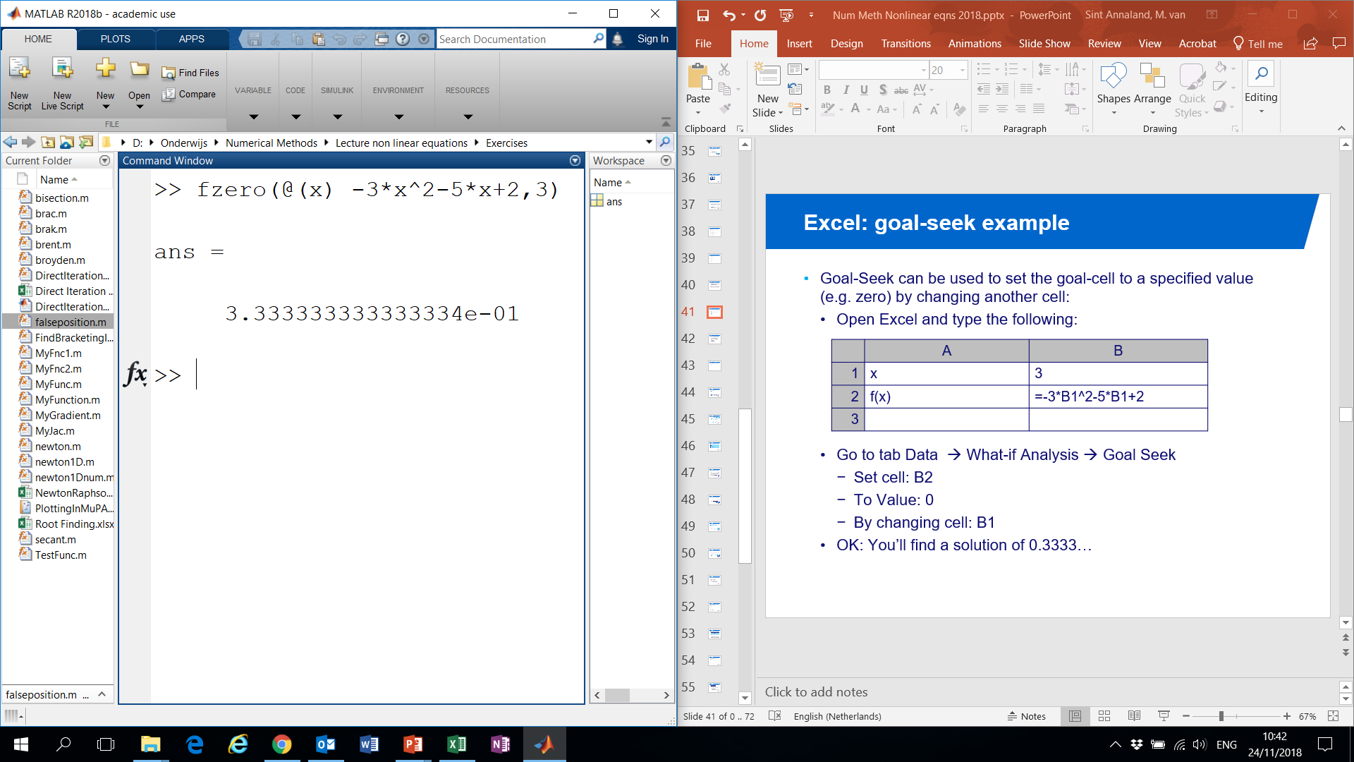
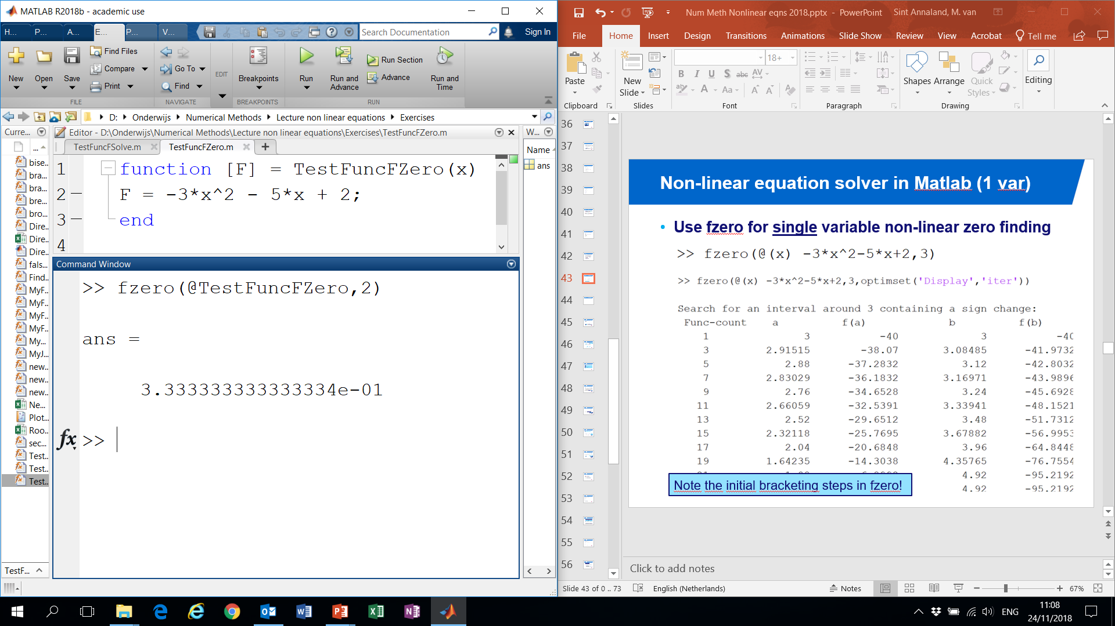
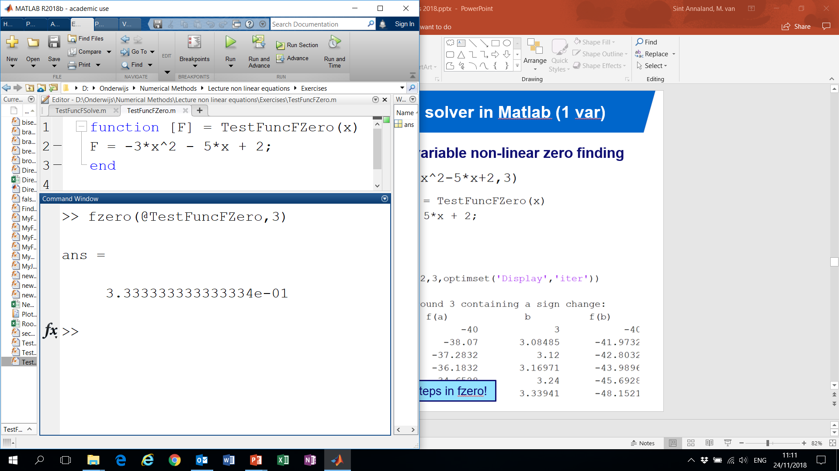
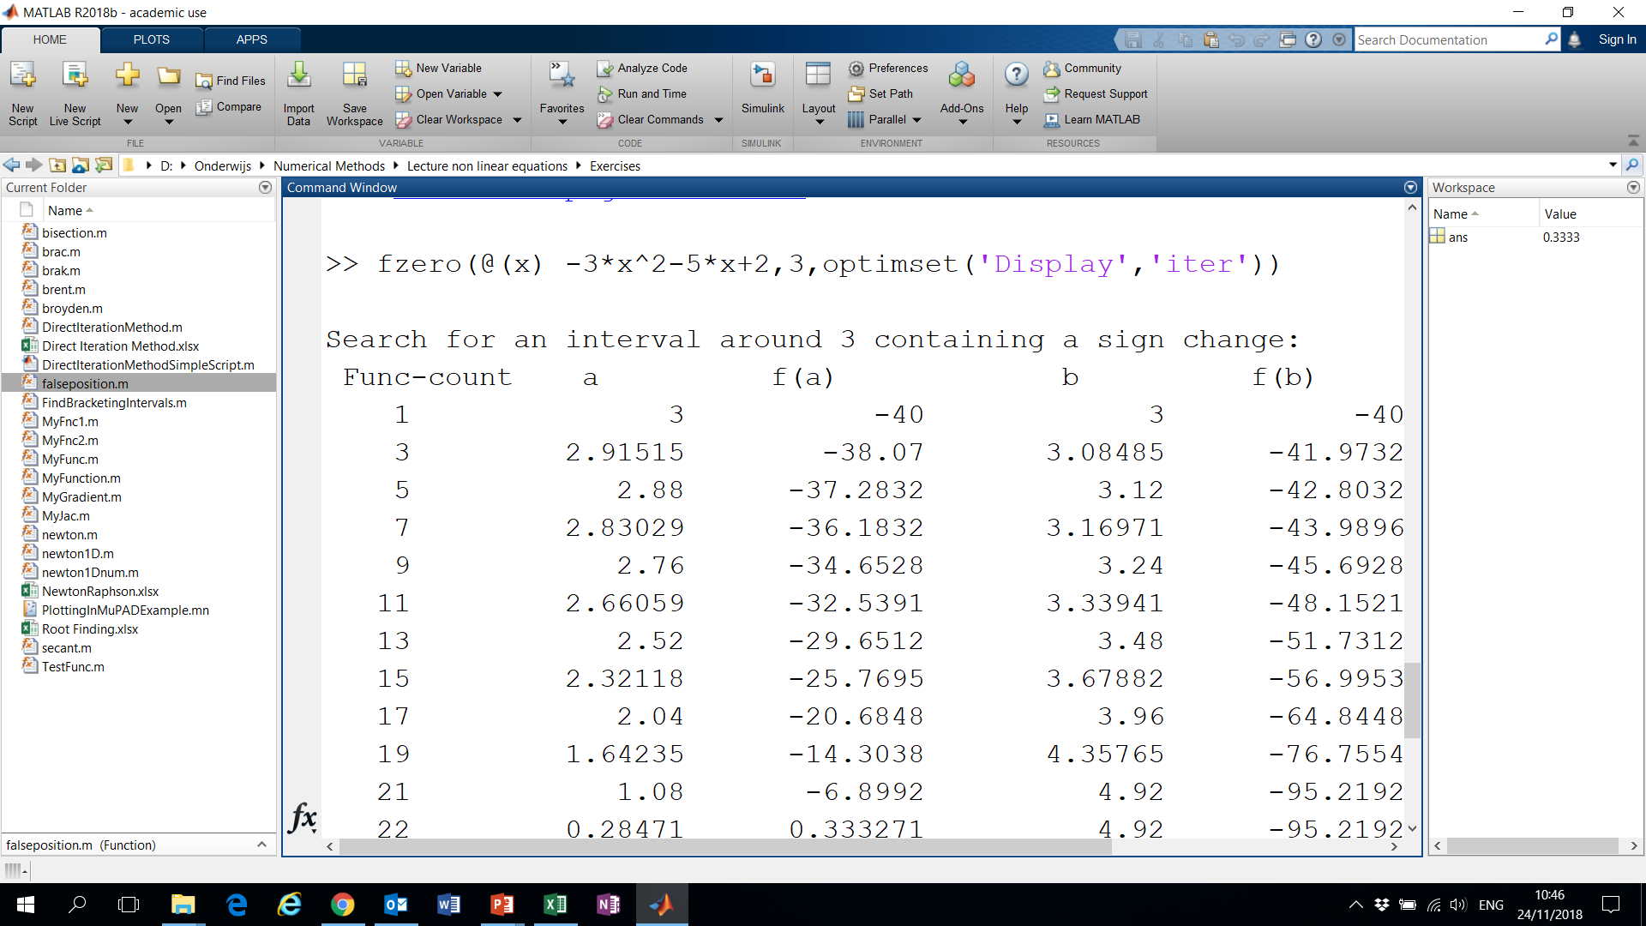
Non-linear equation solver in Matlab (1 var)
Use fzero for single variable non-linear zero finding
Or with
Note the initial bracketing steps in fzero!

Slide 46
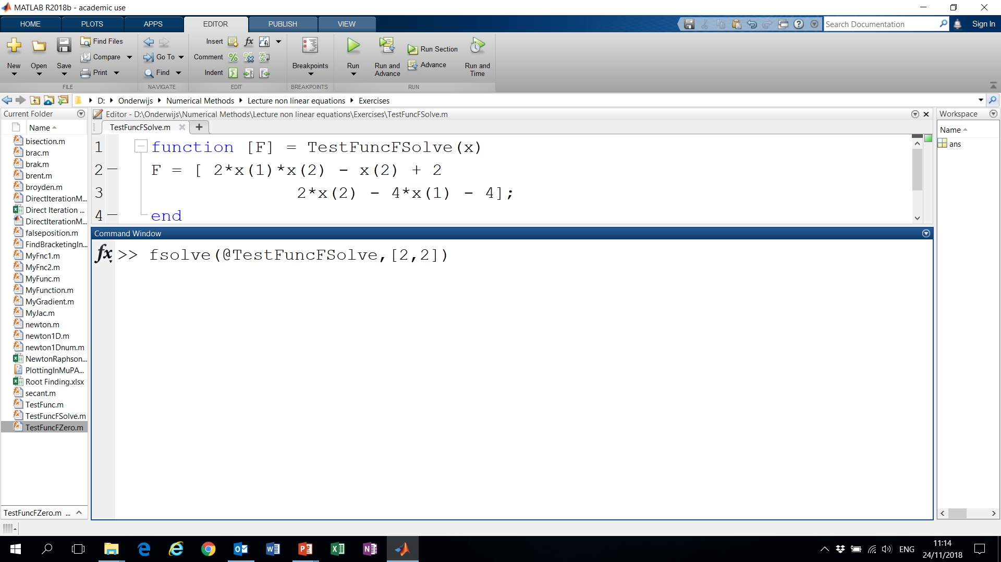
Non-linear equation solver in Matlab (≥ 2 var)
Use fsolve for systems of non-linear equations with multiple variables

Slide 47
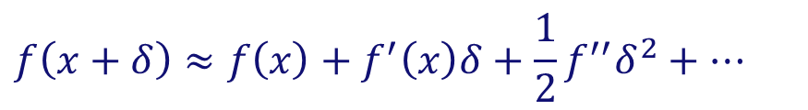
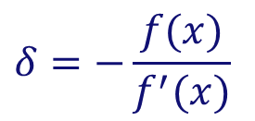
Newton-Raphson method
Requires the evaluation of the function f(x) and the derivative f ′(x) at arbitrary points
Algorithm:
Extend tangent line at current point x_{i} till it crosses zero
Set next guess x_{i+1} to the abscissa of that zero crossing
$$f\left(x+δ\right)≈f\left(x\right)+f^{′}\left(x\right)δ+\frac{1}{2}f^{′′}δ^{2}+…$$
(Taylor series at x)
For small enough values of δ and for well-behaved functions, the non-linear terms become unimportant
$$δ=−\frac{f(x)}{f^{′}(x)}$$
Can be extended to higher dimensions
Requires an initial guess sufficiently close to the root! (otherwise even failure!!)
⇒

Slide 48
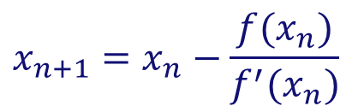
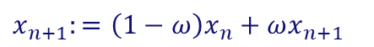
Newton-Raphson method
Example:
f(x)
1
Newton-Raphson method:
$$x_{n+1}=x_{n}−\frac{f(x_{n})}{f^{′}(x_{n})}$$
3
Enormously fast convergence, ….when it works
2
WHEN IT DOES NOT WORK…
1
Sometimes underrelaxation can help...
$$x_{n+1}:=\left(1−ω\right)x_{n}+ωx_{n+1}$$
2

Slide 49
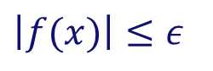

Newton-Raphson method
Basic algorithm:
Given initial x, required tolerance ε > 0
Repeat
Compute f(x) and f′(x).
If , return x
until maximum number of iterations is exceeded
$$\left|f(x)\right|≤ε$$
$$x≔x−{f(x)}/{f^{′}(x)}$$

Slide 50



Newton-Raphson method
Exercise 5: Newton-Raphson method in Excel
$$x_{n+1}=x_{n}+δx_{n}$$
$$δx_{n}=\frac{−f_{n}}{{\frac{df}{dx}}_{n}}$$

Slide 51







Newton-Raphson method
Why is Newton-Raphson so powerful?
⇒ High rate of convergence
$$x_{n+1}=x_{n}−\frac{f\left(x_{n}\right)}{f^{′}\left(x_{n}\right)}$$
Newton-Raphson method:
$$x_{n+1}−x^{∗}=x_{n}−x^{∗}−\frac{f\left(x_{n}\right)}{f^{′}\left(x_{n}\right)}$$
Subtracting the solution x*:
$$ε_{n+1}=ε_{n}−\frac{f\left(x_{n}\right)}{f^{′}\left(x_{n}\right)}$$
$${ε_{n}=x}_{n}−x^{∗}$$
Defining the error :
$$ε_{n+1}=ε_{n}−\frac{f\left(x^{∗}\right)+f^{′}\left(x^{∗}\right)ε_{n}+\frac{1}{2}f^{′′}\left(x^{∗}\right)ε_{n}^{2}+…}{f^{′}\left(x^{∗}\right)+…}$$
$$ε_{n+1}=ε_{n}−ε_{n}−\frac{1}{2}\frac{f^{′′}\left(x^{∗}\right)}{f^{′}\left(x^{∗}\right)}ε_{n}^{2}$$
$$ε_{n+1}\sim Kε_{n}^{2}$$
⇒
Quadratic convergence!!

Slide 52







Newton-Raphson method
Order of convergence
$$\lim_{n→∞}{\frac{\left|ε_{n+1}\right|}{{\left|ε_{n}\right|}^{m}}=K}$$
m = order of convergence K = asymptotic error constant
$$ε_{n}=x_{n}−x^{∗}$$
with x* the solution
When the solution is not known a priori:
$$ε_{n+1}≈x_{n+1}−x_{n}$$
$$\frac{\left|ε_{n+1}\right|}{\left|ε_{n}\right|}=\frac{K{\left|ε_{n}\right|}^{m}}{K{\left|ε_{n−1}\right|}^{m}}$$
$$\frac{\left|ε_{n+1}\right|}{\left|ε_{n}\right|}={\left(\frac{\left|ε_{n}\right|}{\left|ε_{n−1}\right|}\right)}^{m}$$
⇒
$$m=\frac{\ln\left(\frac{\left|ε_{n+1}\right|}{\left|ε_{n}\right|}\right)}{\ln\left(\frac{\left|ε_{n}\right|}{\left|ε_{n−1}\right|}\right)}$$
$$\ln\left(\frac{\left|ε_{n+1}\right|}{\left|ε_{n}\right|}\right)=m ln\left(\frac{\left|ε_{n}\right|}{\left|ε_{n−1}\right|}\right)$$
⇒
for n → ∞

Slide 53




Newton-Raphson method
Exercise 5: Newton-Raphson method in Excel
$$ε_{n}=x_{n}−x^{∗}$$
$$m=\frac{\ln\left(\frac{\left|ε_{n+1}\right|}{\left|ε_{n}\right|}\right)}{\ln\left(\frac{\left|ε_{n}\right|}{\left|ε_{n−1}\right|}\right)}$$
$$=x^{∗}$$

Slide 54
Newton-Raphson method
Exercise 6:
Write a function in MATLAB to find a root of a function using the Newton-Raphson method
Assume that an initial guess x₀ is provided
Also the required tolerance is given
Output the results for every iteration
Verify that at every iteration the number of significant digits doubles, and compute the order of convergence

Slide 55

Newton-Raphson method
Exercise 6: Newton-Raphson in MATLAB
>> newton1D(@(x) x^2-4*x+2, @(x) 2*x-4,1,1e-12,1e-12)
Convergence in 6 iterations. Why does it not work with an initial guess of x₀ = 2??

Slide 56

Newton-Raphson method
Modifications to the basic algorithm
If the first derivative f ′(x) is not known or cumbersome to compute/program, we can use the local num. approximation:
Unless you know that the initial guess is close to the solution, the Newton-Raphson method should be combined with:
a bracketing method, to reject the solution if it wanders outside of the bounds;
Reduced Newton step method (= relaxation) for more robustness. Don’t take the entire step if the error does not decrease (enough)
More sophisticated step size control: Local line searches and backtracking using cubic interpolation (for global convergence)
$$f′(x)≈\frac{f\left(x+dx\right)−f(x)}{dx}$$
(dx ~ 10⁻⁸)
dx should be small (otherwise the method reduces to first order)
But not too small (otherwise you will be wiped out by roundoff!)

Slide 57

Newton-Raphson method
Exercise 6: Newton-Raphson in MATLAB
Numerical differentiation
>> newton1Dnum(@(x) x^2-4*x+2,1,1e-12,1e-12)
Convergence also in 6 iterations!

Slide 58
Newton-Raphson method
How to solve:
One dimensional case:
“Bracket or ‘trap’ a root between bracketing values, then hunt it down like a rabbit.”
Multi-dimensional case:
N equations in N unknowns: You can only hope to find a solution. It may have no (real) solution, or more than one solution!
Much more difficult!! “You never know whether a root is near, unless you have found it”
$$f\left(x\right)=0$$
for arbitrary functions f
“Root finding”
(i.e. move all terms to the left)
$$f\left(x\right)=0$$
$$f\left(x\right)=0$$

Slide 59



Newton-Raphson method
Extensions to multi-dimensional case:
Let’s first consider the two-dimensional case:
$f\left(x,y\right)=0$
$g\left(x,y\right)=0$
Multi-variate Taylor series expansion:
$f\left(x+δx,y+δy\right)≈f\left(x,y \right)+\frac{∂f}{∂x}δx+\frac{∂f}{∂y}δy+O\left(δx^{2},δy^{2}\right)=0$
$g\left(x+δx,y+δy\right)≈g\left(x,y \right)+\frac{∂g}{∂x}δx+\frac{∂g}{∂y}δy+O\left(δx^{2},δy^{2}\right)=0$
Neglecting higher order terms:
$$\frac{∂f}{∂x}δx+\frac{∂f}{∂y}δy=−f\left(x,y \right)$$
$$\frac{∂g}{∂x}δx+\frac{∂g}{∂y}δy=−g\left(x,y \right)$$
Two linear equations in the two unknowns δx and δy.
⇒

Slide 60



Newton-Raphson method
Extensions to multi-dimensional case:
Newton-Raphson method:
Or in matrix notation:
$$\frac{∂f}{∂x}δx+\frac{∂f}{∂y}δy=−f\left(x,y \right)$$
$$\frac{∂g}{∂x}δx+\frac{∂g}{∂y}δy=−g\left(x,y \right)$$
$$\left[\begin{matrix}\frac{∂f}{∂x} & \frac{∂f}{∂y} \\ \frac{∂g}{∂x} & \frac{∂g}{∂y}\end{matrix}\right]∙\left[\begin{matrix}δx \\ δy\end{matrix}\right]=−\left[\begin{matrix}f\left(x,y\right) \\ g\left(x,y\right)\end{matrix}\right]$$
Solution via Cramer’s rule:
Jacobian matrix
$δx={\left|\begin{matrix}−f & \frac{∂f}{∂y} \\ −g & \frac{∂g}{∂y}\end{matrix}\right|}/{\left|\begin{matrix}\frac{∂f}{∂x} & \frac{∂f}{∂y} \\ \frac{∂g}{∂x} & \frac{∂g}{∂y}\end{matrix}\right|=\frac{−f\frac{∂g}{∂y}+g\frac{∂f}{∂y}}{\frac{∂f}{∂x} \frac{∂g}{∂y}−\frac{∂f}{∂y}\frac{∂g}{∂x}}}$
$δy={\left|\begin{matrix}\frac{∂f}{∂x} & −f \\ \frac{∂g}{∂x} & −g\end{matrix}\right|}/{\left|\begin{matrix}\frac{∂f}{∂x} & \frac{∂f}{∂y} \\ \frac{∂g}{∂x} & \frac{∂g}{∂y}\end{matrix}\right|=\frac{−g\frac{∂f}{∂x}+f\frac{∂g}{∂x}}{\frac{∂f}{∂x} \frac{∂g}{∂y}−\frac{∂f}{∂y}\frac{∂g}{∂x}}}$

Slide 61


























Newton-Raphson method
Extensions to multi-dimensional case:
Example: intersection of circle with parabola:
In matrix form:
$$x^{2}+y^{2}=4$$
⇒
$$f=\left[\begin{matrix}f_{1} \\ f_{2}\end{matrix}\right]=\left[\begin{matrix}x_{1}^{2}+x_{2}^{2}−4 \\ x_{1}^{2}−x_{2}+1\end{matrix}\right]$$
$$x=\left[\begin{matrix}x_{1} \\ x_{2}\end{matrix}\right]$$
$J=\left[\begin{matrix}2x_{1} & 2x_{2} \\ 2x_{1} & −1\end{matrix}\right]$
$${y=x}^{2}+1=0$$
$$x^{(i)}$$
$$f^{(i)}$$
$$J^{(i)}$$
$${δx}^{(i)}$$
$$\left[\begin{matrix}1 \\ 2\end{matrix}\right]$$
$\left[\begin{matrix}2 & 4 \\ 2 & −1\end{matrix}\right]$
i = 1:
$$\left[\begin{matrix}1 \\ 0\end{matrix}\right]$$
$\left[\begin{matrix}−0.1 \\ −0.2\end{matrix}\right]$
$$\left[\begin{matrix}0.9 \\ 1.8\end{matrix}\right]$$
$\left[\begin{matrix}1.8 & 3.6 \\ 1.8 & −1\end{matrix}\right]$
i = 2:
$$\left[\begin{matrix}0.05 \\ 0.01\end{matrix}\right]$$
$\left[\begin{matrix}−0.01039 \\ −0.0087\end{matrix}\right]$
$$\left[\begin{matrix}0.889614 \\ 1.791304\end{matrix}\right]$$
$\left[\begin{matrix}1.7792 & 3.5826 \\ 1.7792 & −1\end{matrix}\right]$
i = 3:
$$\left[\begin{matrix}0.000183 \\ 0.0000108\end{matrix}\right]$$
$\left[\begin{matrix}−6.99∙{10}^{−5} \\ −1.65∙{10}^{−5}\end{matrix}\right]$
$$\left[\begin{matrix}0.8895436 \\ 1.7912878\end{matrix}\right]$$
$\left[\begin{matrix}1.779087 & 3.582576 \\ 1.779087 & −1\end{matrix}\right]$
i = 4:
$$\left[\begin{matrix}5.16∙{10}^{−9} \\ 4.89∙{10}^{−9}\end{matrix}\right]$$
$\left[\begin{matrix}−2.78∙{10}^{−9} \\ −5.94∙{10}^{−11}\end{matrix}\right]$

Slide 62


Newton-Raphson method
Extensions to multi-dimensional case:
Example: intersection of circle with parabola:
Check order of convergence:
Quadratic convergence! = doubling number of significant digits every iteration
$$ε_{n+1}≈x_{n+1}−x_{n}$$
$$m=\frac{\ln\left(\frac{\left|ε_{n+1}\right|}{\left|ε_{n}\right|}\right)}{\ln\left(\frac{\left|ε_{n}\right|}{\left|ε_{n−1}\right|}\right)}$$

Slide 63









Newton-Raphson method
Extensions to multi-dimensional case:
Generalization to the N-dimensional case:
$$f_{i}\left(x_{1},x_{2},…,x_{N}\right)=0$$
for i = 1, 2, …, N
Define:
$$x=\left[x_{1},x_{2},…,x_{N}\right]$$
$$f\left(x\right)=0$$
and
$$f=\left[f_{1},f_{2},…,f_{N}\right]$$
⇒
Multi-variate Taylor series expansion:
$$f_{i}\left(x+δx\right)=f_{i}\left(x\right)+\sum_{j=1}^{N}{\frac{∂f_{i}}{∂x_{j}}δx_{j}}+O\left(δx^{2}\right)$$
Define Jacobian matrix:
$$J_{ij}=\frac{∂f_{i}}{∂x_{j}}$$
⇒
$$f\left(x+δx\right)=f\left(x\right)+J∙δx+O\left(δx^{2}\right)$$
$$J∙δx=−f\left(x\right)$$
Neglect higher order terms:
$$x_{new}=x_{old}+δx$$

Slide 64



Newton-Raphson method
Multi-variate Newton-Raphson in MATLAB
⇒ Only 5 iterations needed!
>> newton(@MyFunc,@MyJac,[1;2],1e-12,1e-12)

Slide 65

Newton-Raphson method
Multi-variate Newton-Raphson in MATLAB
Plotting the functions:
>> mphandle = mupad

Slide 66

Newton-Raphson method
Multi-variate Newton-Raphson in MATLAB
Plotting the norm of the function:

Slide 67

Newton-Raphson method
Multi-variate Newton-Raphson in MATLAB
Plotting contours of the norm of the function:

Slide 68





Broyden’s method
Multi-dimensional secant method (‘quasi-Newton’):
Disadvantage of the Newton-Raphson method:
It requires the Jacobian matrix
In many problems no analytical Jacobian available
If the function evaluation is expensive, the numerical approximation using finite differences can be prohibitive!
⇒
use cheap approximation of the Jacobian!
(= secant, or ‘quasi-Newton’ method)
Newton-Raphson:
Secant method:
$$J^{n}∙δx^{n}=−f^{n}\left(x^{n}\right)$$
$$B^{n}$$
= approximation of the Jacobian
$$B^{n}∙δx^{n}=−f^{n}\left(x^{n}\right)$$
$$x^{n+1}=x^{n}+δx^{n}$$
$$x^{n+1}=x^{n}+δx^{n}$$

Slide 69





Broyden’s method
Multi-dimensional secant method (‘quasi-Newton’):
Secant equation (generalization of 1D case):
$$B^{n+1}∙δx^{n}=δf^{n}$$
$$δx^{n}=x^{n+1}−x^{n}$$
$$δf^{n}=f^{n+1}−f^{n}$$
Underdetermined (i.e. not unique: n equations with n² unknowns ) ⇒ we need another condition to pin down B^{n+1}
Broyden’s method: determine B^{n+1} by making the least change to B^{n} that is consistent with the secant condition
$$B^{n+1}=B^{n}+\frac{\left(δf^{n}−B^{n}∙δx^{n}\right)}{δx^{n}∙δx^{n}}⨂δx^{n}$$
Updating formula:
(Note: sometimes B⁻¹ is updated directly)
$$\left(a⨂b=ab^{T}\right)$$

Slide 70






Broyden’s method
Multi-dimensional secant method (‘quasi-Newton’):
Background of Broyden’s method:
Secant equation:
$$B^{n+1}∙δx^{n}=δf^{n}$$
Broyden’s method: Since there is no update on derivative info, why would B^{n} change in a direction w orthogonal to
$$δx^{n}$$
⇒
$${\left(δx^{n}\right)}^{T}w=0$$
$$B^{n+1}∙w=B^{n}∙w$$
$$B^{n+1}=B^{n}+\frac{\left(δf^{n}−B^{n}∙δx^{n}\right)}{δx^{n}∙δx^{n}}⨂δx^{n}$$
⇒
$$B^{n+1}∙δx^{n}=δf^{n}$$
Initialize B⁰ with identity matrix (or with finite difference approx.)

Slide 71

Broyden’s method
Same example as before but now with Broyden’s method
Slower convergence with Broyden’s method should be offset by improved efficiency of each iteration!
>> broyden(@MyFunc,[1;2],1e-12,1e-12)
Requires 11 iterations (compare with Newton: 5 iterations)
But much fewer function evaluations per iteration!

Slide 72











Broyden’s method
Same example as before but now with Broyden’s method
Note how the approximate Jacobian (B) is updated over subsequent iterations:
$\left[\begin{matrix}1 & 0 \\ 0 & 1\end{matrix}\right]$
$\left[\begin{matrix}1 & 0 \\ 1 & 1\end{matrix}\right]$
$\left[\begin{matrix}1 & 5 \\ 1 & −1\end{matrix}\right]$
$\left[\begin{aligned}1.0225 4.9685 \\ 0.9437 −0.9212\end{aligned}\right]$
$\left[\begin{aligned}2.0881 4.6442 \\ 1.7312 −1.1608\end{aligned}\right]$
$\left[\begin{aligned}1.7932 4.6321 \\ 1.8420 −1.1563\end{aligned}\right]$
$\left[\begin{aligned}2.0222 3.6454 \\ 1.8043 −0.9940\end{aligned}\right]$
$\left[\begin{aligned}2.0032 3.5423 \\ 1.8024 −1.0043\end{aligned}\right]$
$\left[\begin{aligned}1.9295 3.4553 \\ 1.7948 −1.0133\end{aligned}\right]$
$\left[\begin{aligned}1.9284 3.4539 \\ 1.7945 −1.0136\end{aligned}\right]$
Compare with exact Jacobian:
$\left[\begin{matrix}1.779087 & 3.582576 \\ 1.779087 & −1\end{matrix}\right]$
…
Note that the approximate Jacobian (B) is not exact even when the solution has already been found!
⇒

Slide 73
Conclusions
Recommendations for root finding:
One-dimensional cases:
If it is not easy/cheap to compute the function’s derivative ⇒ use Brent’s algorithm
If derivative information is available ⇒ use Newton-Raphson’s method + bookkeeping on bounds provided you can supply a good enough initial guess!!
There are specialized routines for (multiple) root finding of polynomials (but not covered in this course)
Multi-dimensional cases:
Use Newton-Raphson method, but make sure that you provide an initial guess close enough to achieve convergence
In case derivative information is expensive ⇒ use Broyden’s method (but slower convergence!)

